Slide 2
Presentation Title
Le Tuan Hung l Agentic AI the next through of Generative AI

Slide 3
Agentic AI – The Next Breakthrough After GenAI
1. Why is there an explosion of AI ?
2. Why is GenAI not enough ?
3. The upgrade from GenAI to Agentic AI
4. Applications & Future of Agentic AI
5. Q&A

Slide 4
Why is there an explosion of AI

Slide 5
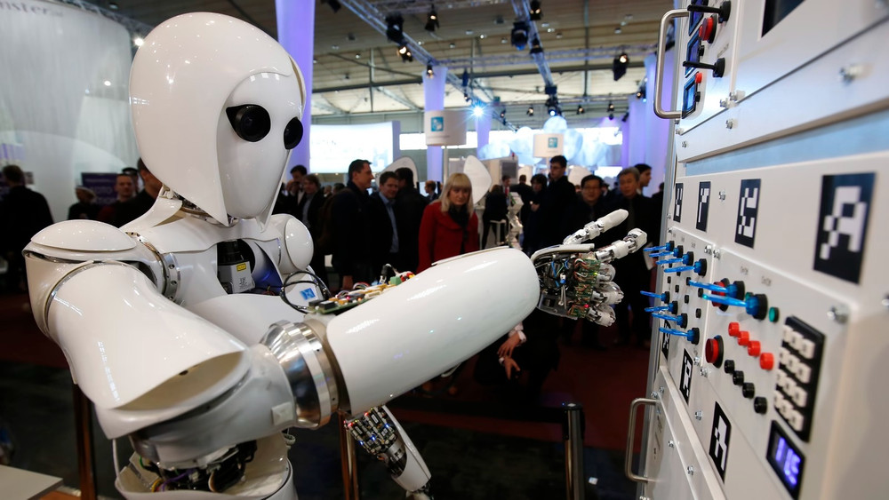
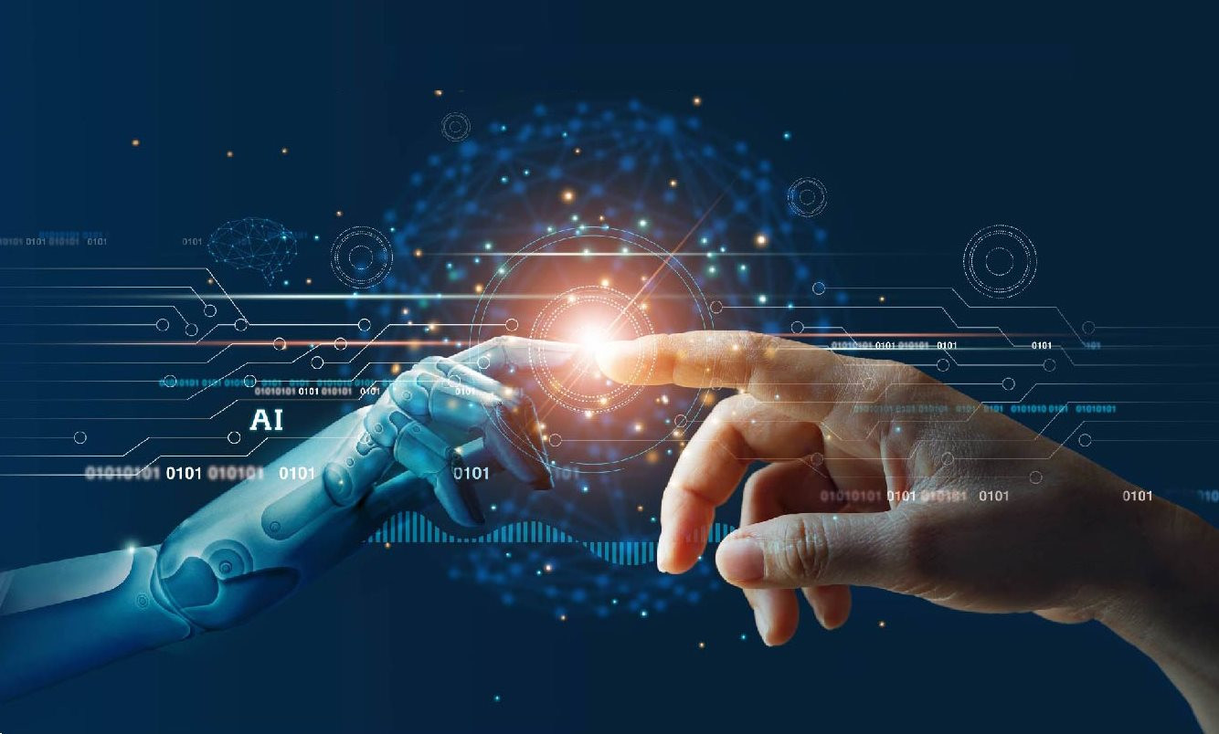
Why is there an explosion of AI
Before 2017
Can’t read big data from human
Read sequentially => Very low
Human language is very ironic
Example
I can’t fit the laptop into the bag because it’s too big
I can’t fit the laptop into the bag because it’s too small

Slide 6
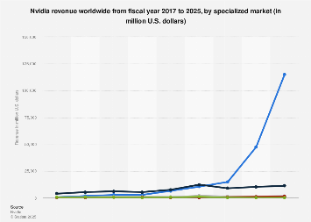
Why is there an explosion of AI
Transformer
Read the entire context
Find the relation between words
Undergoes multiple layers of analysis
Solve problems
Solving the data access problem
Need GPU process
=> NVIDIA explodes
All companies join, and that is the main reason explosion of AI

Slide 7
Why is GenAI not enough

Slide 8
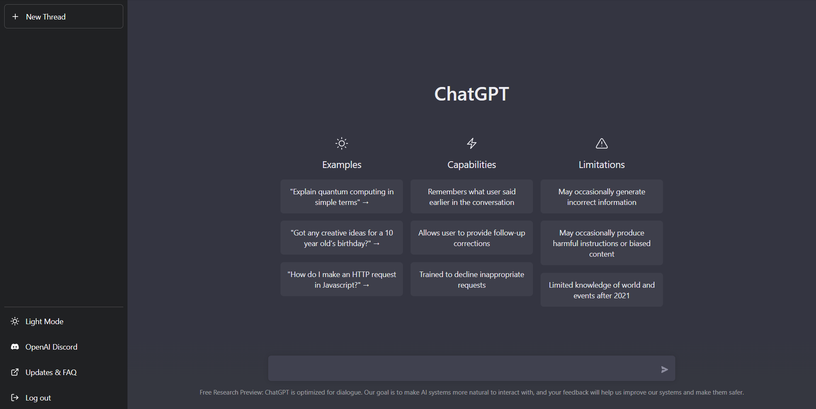
The development of GenAI
In 2022
Chat GPT was created
Chat interface, like a human
100 million users
Change the way learn and work

Slide 9
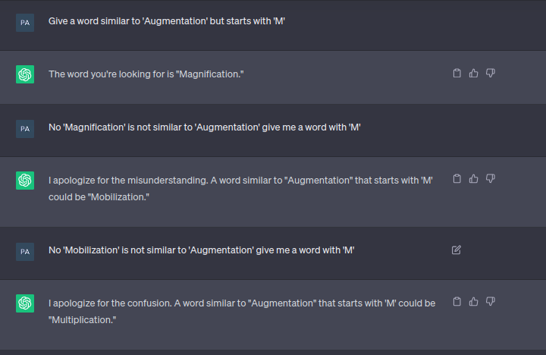
The problems of GenAI
Hallucination
Context window
Knowing, not doing

Slide 10
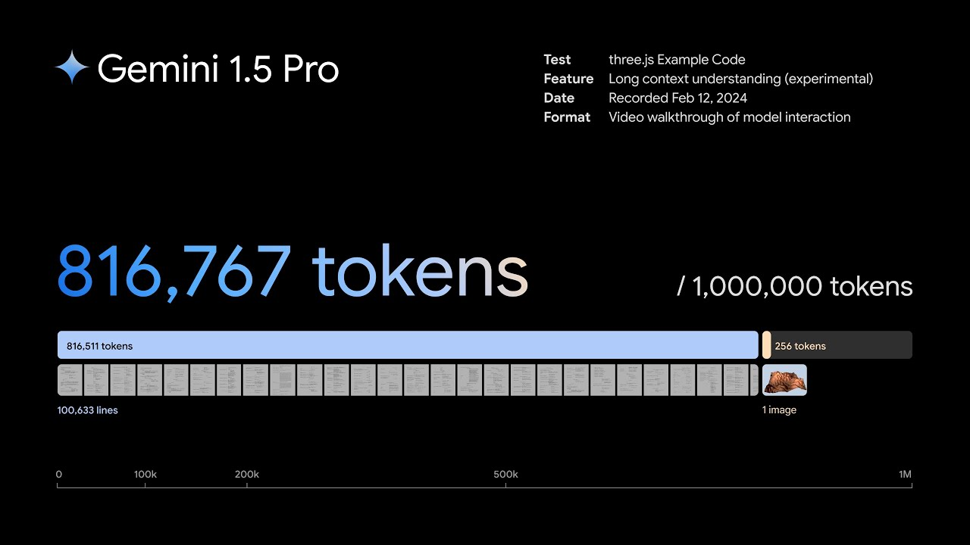
How to solve this problems
Many companies find solution
Google released Gemini 1.5
GenAI offers many things, but, it still needs human intervention
Agentic AI released

Slide 11
The upgrade from GenAI to Agentic AI

Slide 12
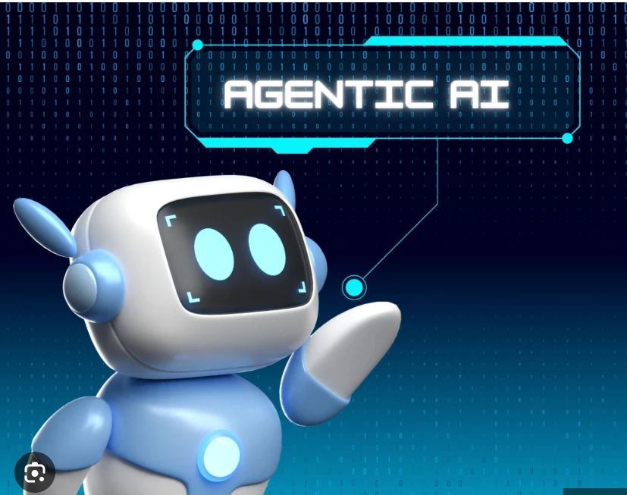
Agentic AI
Agentic AI
Goad-driven – understands and works toward objectives
Autonomous – acts without step-by-step instructions
Planning – creates and executes multi-step workflows
Adaptive – monitors progress and adjusts actions

Slide 13
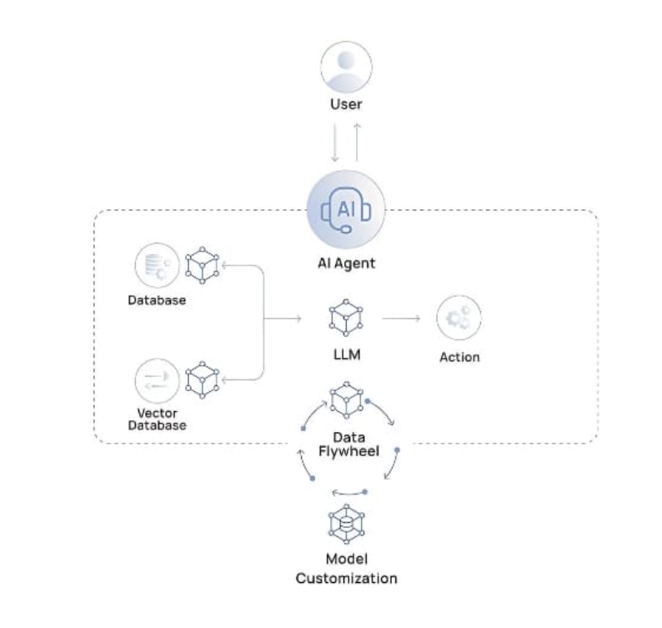
Agentic AI
Four steps
Perceive
Reason
Act
Learn
=> Operate like a center where interact with user, data, big data and action learning process

Slide 14
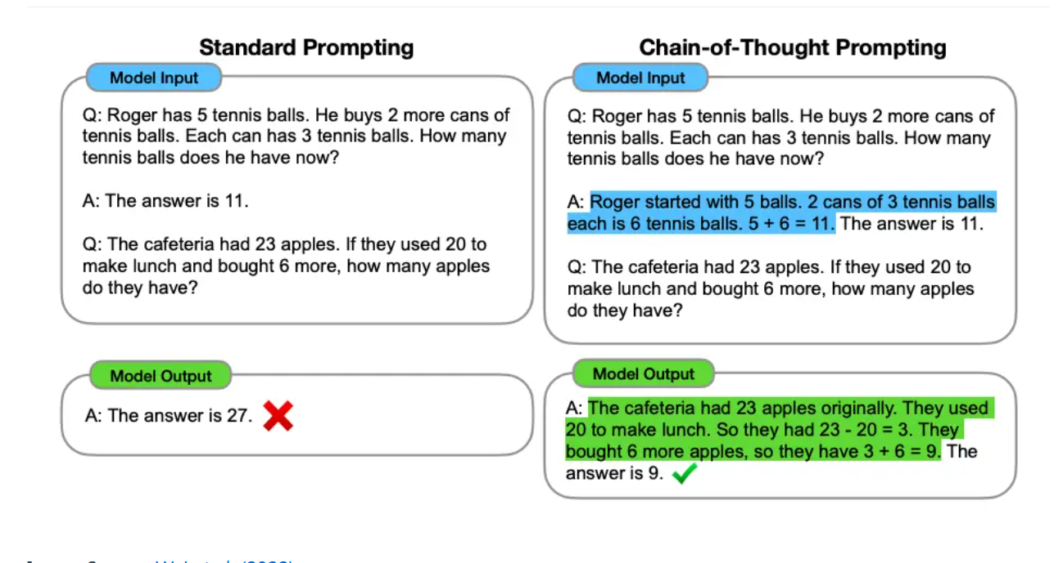
Agentic AI
GenAI
Fast Answer, immediately - > but sometimes it has wrong answer
Chain of thought term
Thinking first
Draft each step carefully before staring the actual work

Slide 15
Agentic AI
GenAI
Fast Answer, immediately - > but sometimes it has wrong answer
Chain of thought term
Thinking first
Draft each step carefully before staring the actual work

Slide 16
Applications & Future of Agentic AI

Slide 17
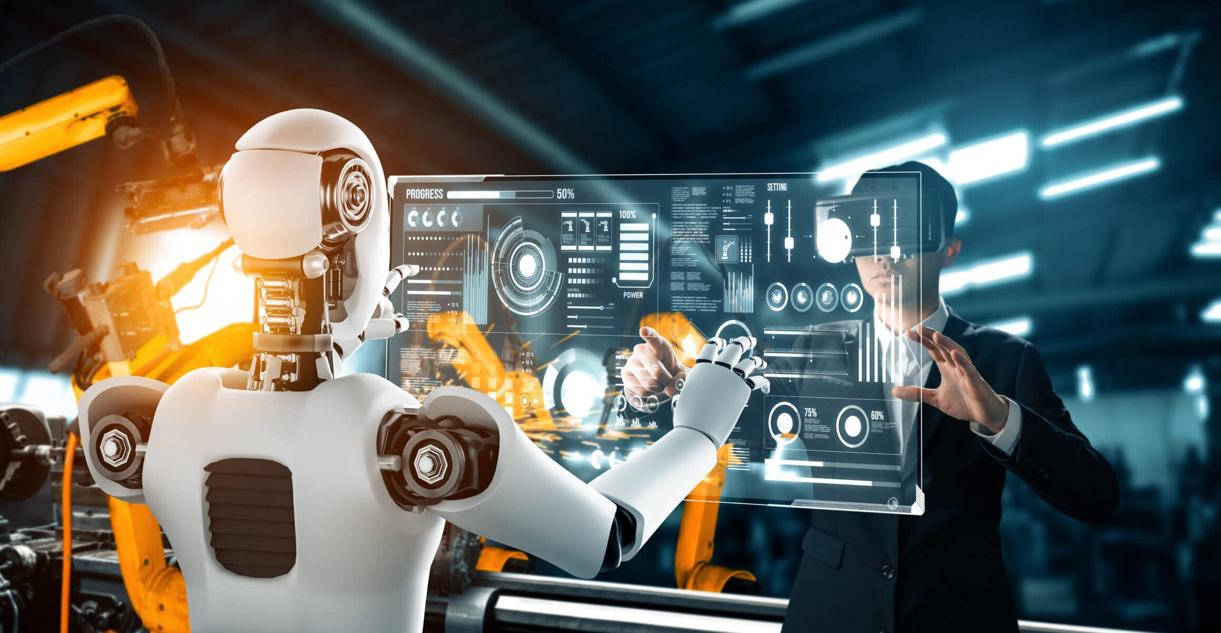
Agentic AI Applications
Manufacture
Automated monitoring
Anomaly detection
Optimizing automated processes
Predictive analytics

Slide 18
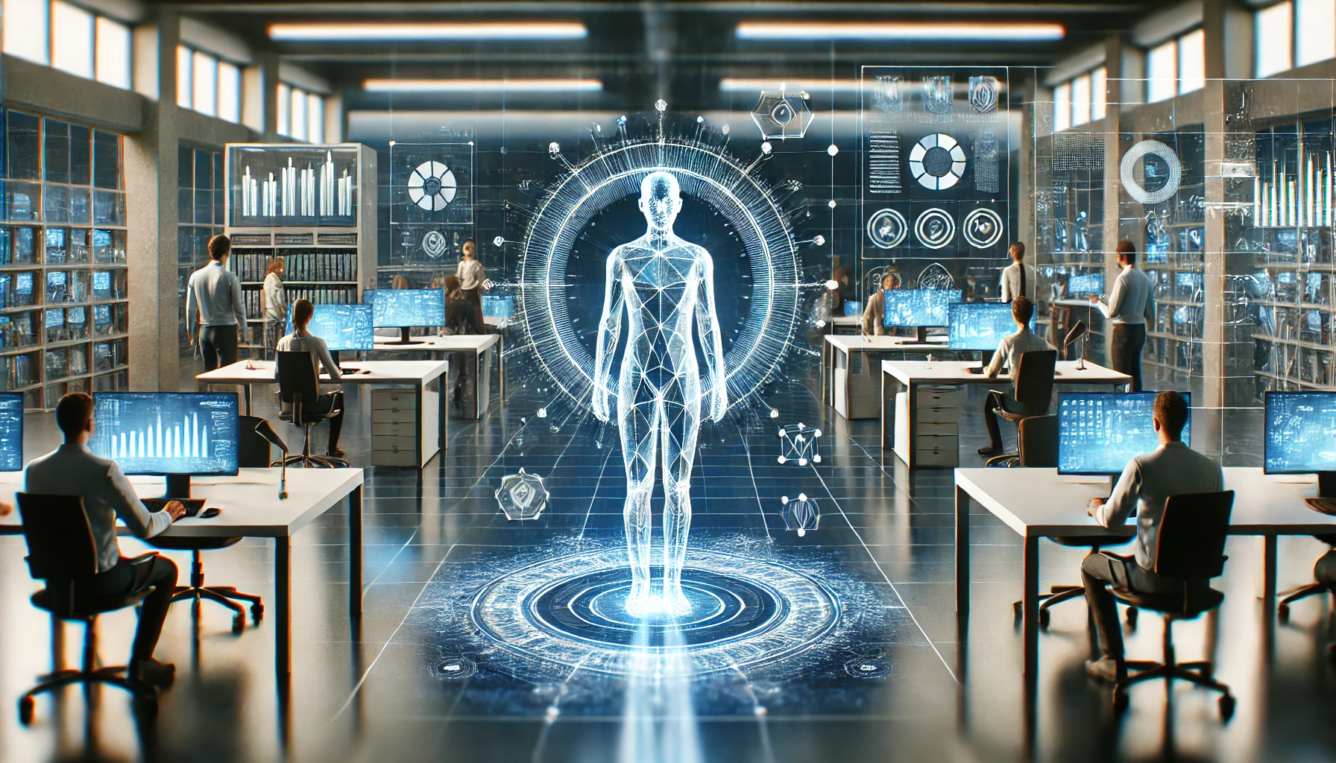
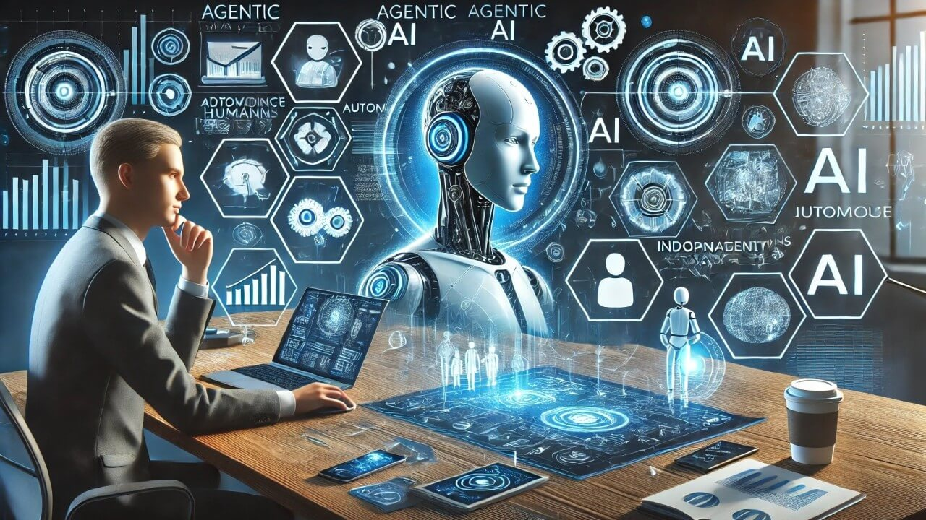
Agentic AI Future
Creating outstanding competitive advantage
A chance to move in sync with the world
Massive AI power = New opportunities for early adopters

Slide 19

Q&A

